Slide 2

ASHRAE’s Building EQ
Be an Energy Genius
Presented by Doug Cochrane, P.Eng., LEED AP, MAshrae
Distinguished Lecturer
May 7, 2021
Notes:
Building EQ webpage: www.ashrae.org/buildingEQ
Building EQ Video: https://www.youtube.com/watch?v=8UprJpl5cMs&t=3s
Building EQ Portal Training: https://www.youtube.com/watch?v=K45K0YfOjpU&t=45s
NOTE:
Most of the photos in the presentation with people come from and feature the actors in the Building EQ video listed above.
The 2 minute video provides a broad overview of the Building EQ program.

Slide 3
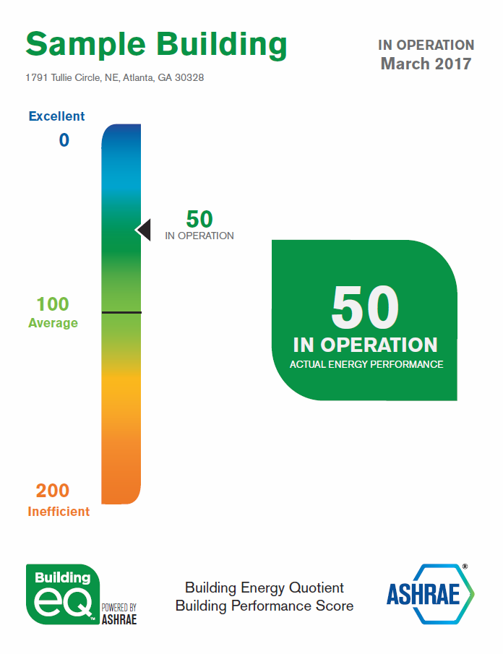
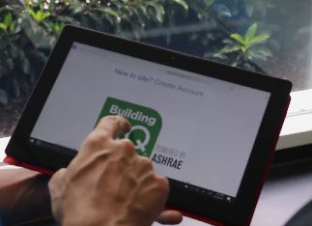
What is Building EQ?
Online Web-based Portal
Calculates building EUI based on CZ
Benchmarks energy performance
Not an energy modeling tool
Assists with ASHRAE Level 1 Energy Audit
Generates Building Energy Performance Score
Provides data to improve energy performance
Notes:
CZ = Climate Zone
EUI = Energy Use Intensity – Btu/yr-ft²
IO = In Operation
AD = As Designed
The Building EQ Portal is an online tool that includes:
Online data entry and submission process
Download of metered energy data from ENERGY STAR™ Portfolio Manager
Building EQ is a web based portal that compares your building’s performance with similar building types.
offers a consistent methodology,
can also compare buildings within an owner’s portfolio against each other
can be re‐evaluated over time to see if the improvements are getting the expected energy savings and performance results.
allows owners to invest financial resources in their buildings in the ways that will provide the greatest return.

Slide 4


Other Energy Reporting Programs
EPA ENERGY STAR Portfolio Manager – Benchmarking
DOE Building Energy Asset Score
USGBC LEED – Broader sustainability rating
GBI Green Globes – Broader sustainability rating
BOMA 360 – Six O&M focused criteria (including energy)
Mandatory state and local benchmarking, labeling, and disclosure programs
Notes:
Current labeling efforts in North America (USA/Canada)
Information on State & Local rating regulations is available from the BuildingRating website (supported by the Institute for Market Transformation): https://www.buildingrating.org/jurisdictions
Other websites:
• EPA ENERGY STAR: www.energystar.gov
• DOE Asset Score: https://energy.gov/eere/buildings/commercial‐building‐energy‐asset scoring‐tool
• USGBC LEED: www.usgbc.org/leed
• Green Globes: www.greenglobes.com/
• BOMA 360: www.boma.org/360

Slide 5

How Does Building EQ compare?
 | Benchmarking | Energy Audit | Asset Rating
Building EQ
ENERGY STAR Portfolio Manager
DOE Asset Score
ASHRAE Std 211
ISO 50002:2014(en)
Notes:
Building EQ allows for the comparison of a building’s actual energy use (In Operation) to the buildings potential energy use (As Designed).
Both Building EQ and ENERGY STAR both benchmark your building against a baseline of other similar buildings.
Building EQ is a statistical scale that compares the building’s score to a baseline median score and ENERGY STAR is pass/fail (75 or greater) & uses a percentile scale where a score of 75 means that building is better than 75% of other similar buildings
Building EQ assessment assists with the preparation of an ASHRAE Level 1 Energy Audit to identify improvements for the building – these actionable recommendations are generated by a credentialed professional (BEAP, BEMP, PE) with a site visit and recorded measurements.
DOE Asset Score has no credential requirement and the tool automatically generates building improvement suggestions which makes the quality of the suggestions somewhat uncertain.

Slide 6
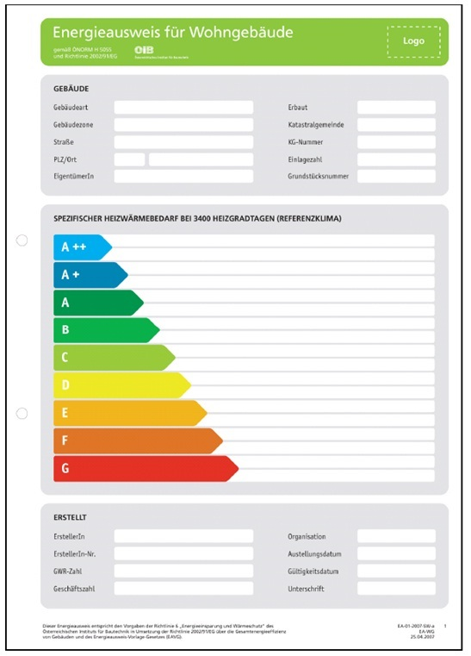
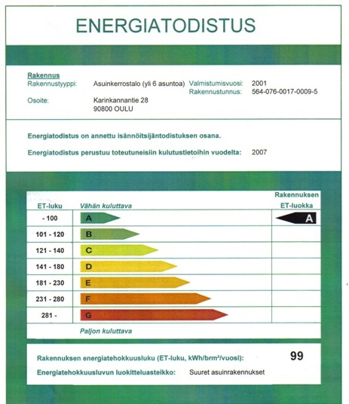
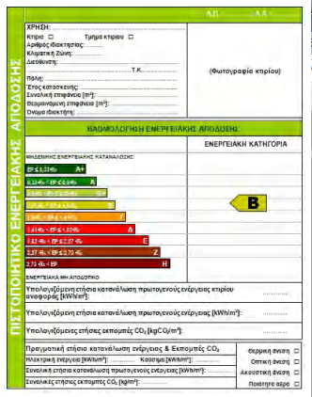
Global Labeling Efforts
Widespread acceptance internationally
Austria
England & Wales
Finland
Greece
Notes:
Current Labeling efforts – Globally/Internationally
Information on the European Union requirements: DIRECTIVE (EU) 2018/844 OF THE EUROPEAN PARLIAMENT AND OF THE COUNCIL of 30 May 2018
amending Directive 2010/31/EU on the energy performance of buildings and Directive 2012/27/EU on energy efficiency.
Member States are obliged to ensure that when buildings are constructed, sold or rented out, an Energy Certificate is made available to the owner or by the owner to the tenant or potential buyer. The certification shall also include advice and information on how to improve energy performance. It concerns such elements as building envelope, windows, heating, electrical and ventilation installations, lighting, heat sources (incl. boilers, CHP units) cooling systems and others. Certain buildings over 500m² are also required to have an energy certificate on public display. This can be an asset rating or an operational rating.

Slide 7
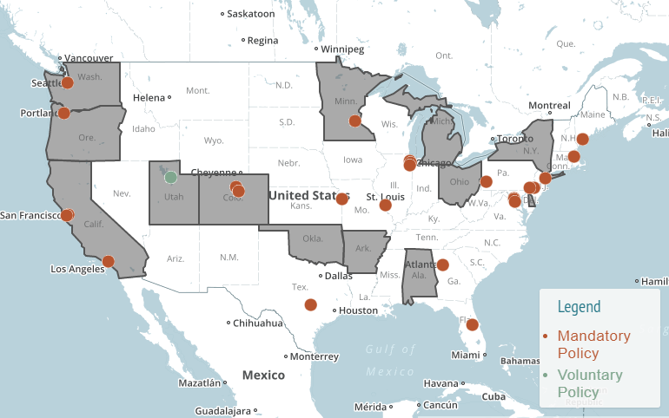
Building Rating Polices & Programs
The map shows jurisdictions focused on improving energy & water performance of their buildings
https://www.buildingrating.org/jurisdictions
Notes:
Current labeling efforts in North America (USA/Canada)
Information on State & Local rating regulations is available from the BuildingRating website (supported by the Institute for Market Transformation): https://www.buildingrating.org/jurisdictions
NOTE: All voluntary programs on the areas covered by this map are in local/city jurisdictions and show up as dots on the map.
Gray shaded states have some level of statewide policies.

Slide 8
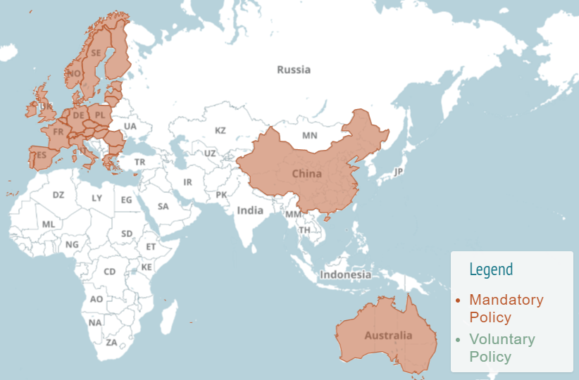
Building Rating Polices & Programs
The map shows jurisdictions focused on improving energy & water performance of their buildings
https://www.buildingrating.org/jurisdictions
Notes:
Current labeling efforts in Europe and Asia
Information on State & Local rating regulations is available from the BuildingRating website (supported by the Institute for Market Transformation): https://www.buildingrating.org/jurisdictions
NOTE: There are no voluntary programs on this areas covered by this map – the Legend applies globally even though no countries shown apply

Slide 9
Building Programs & Policies
Universities using Building EQ to improve campus buildings and provide students with hands on experience in energy auditing and HVAC principles
Florida state legislation recognizes Building EQ as a qualified energy rating options for all buildings (2014 House Bill 7147)
Orlando, Florida city ordinances include Building EQ and ASHRAE Standard 211 for completion of Level 1 Energy Audits

Slide 10
Building EQ Overview
Anyone can get a Building Energy Performance Score
Building Performance Score opens dialog on improvements
Credentialed users submit for official rating
Benchmarks using fixed baseline aligned with Standard 90.1
In Operation assessment based on actual energy use – Resonates with decision makers
As Designed evaluation based on standardized model – Provides additional information for decision makers
Notes:
The Building EQ Performance Score rates the building’s performance and is free to all users.
The Building EQ Performance Score shows on the screen once the required data is entered and provides an indicator of how the building is performing.
The Score and the assessment process start a conversation with the building owner on how to improve the building’s energy performance.
Projects must be submitted by a credentialed practitioners for an official Building EQ rating. Credential users include ASHRAE BEAP, ASHRAE BEMP, and Professional Engineers.
Building EQ is only tool that includes both In Operation (operational) and As Designed (asset) ratings. Taken together the As Designed and In Operation ratings provide a comprehensive view of a buildings current and potential energy performance.
The In Operation assessment is :
Based on actual energy costs
Resonates with decisions makers
Provides actional recommendations for improvement
The As Designed evaluation is:
Based on standardized model of the building
Provides additional information for decision makers
Indicates the building’s potential energy performance

Slide 11
In Operation Assessment
Uses metered energy bills for energy usage
Reflects how the building is designed, used, and operated
Most common application
Rating from 0 (zero net energy) to 200 (energy inefficient)
Allows for tracking of improvements and comparing building to itself over time
Notes:
Building EQ In Operation process compares metered energy use to a baseline median EUI using the following formula: (EUI_{metered}/EUI_{baseline}) X 100.
Twelve consecutive months of actual metered data is required and must be within 6 months of the assessment date.
Metered energy data can be downloaded from ENERGY STAR Portfolio Manager so the data does not need to be reentered into the Portal.
The scale barometer shown illustrates how a building’s Building Performance Score indicates a buildings energy performance with a score range as follows: .
A zero net energy building will have a score of zero (zero net energy use)
An efficient building has a score less than 100 (low energy use / energy use approaching zero net energy use)
An average building will fall near the median value of 100 (equals median or baseline building)
An Inefficient building has a score greater than 100 (above average energy use / high energy use)
The baseline value of 100 also represents the median (similar to mid‐point or average) energy use intensity for existing buildings of that building type.

Slide 12


In Operation Assessment
Celebrate good score with ASHRAE Building EQ Label Award
Start a dialog with owner on how to improve building score
How Good is My Building?
Get energy bills
Do a walk through
Enter data into Portal
Get score
Submit project for official rating
OR
Use project to start conversation
Notes:
Building EQ In Operation assesses the building’s energy performance.
The assessment:
collects metered energy data
includes a building walk-through
supports a Level 1 Energy Audit
identifies where and how energy is consumed,
provides suggested EEMs (with estimated costs and payback),
includes an IEQ screening that records measurements for thermal comfort, lighting, and ventilation for IAQ
provides a Building EQ Performance Score
The assessor gets information that will help the building owner.
The building owner receives guidance on how to improve energy performance.
The estimated time to input the required data into the Portal is approximately 30-60 minutes depending on the size of the building and how much data is being input. This assumes that all the data is readily in hand at the time of input.

Slide 13
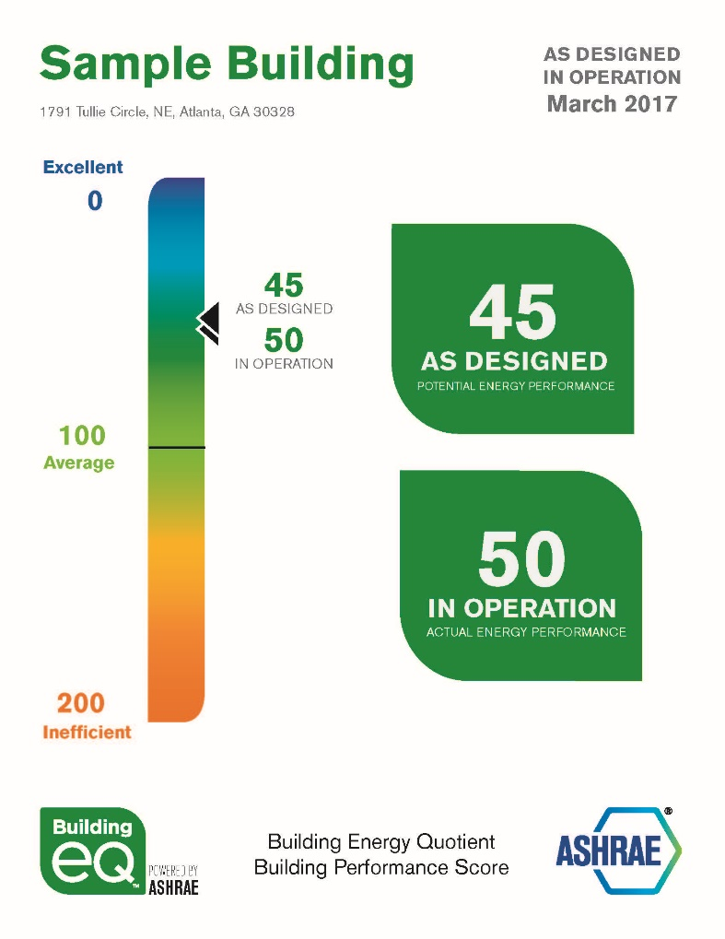
As Designed Assessment
Evaluates potential energy use
Uses standardized energy model
Independent of building occupancy and operating conditions
Rating from 0 (zero net energy) to 200 (energy inefficient)
Notes:
Building EQ As Designed compare a building’s simulated energy consumption to a baseline median EUI using the following formula: (EUI_{simulated}/EUI_{baseline}) X 100.
Utilizes a standardized model of the building being evaluated
Uses standardized inputs of operating parameters from COMNET including: occupancy, plug and process loads, schedules, setpoints. Inputs depend on building and space type.
The baseline (median) EUI is based on the CBECS median for that specific building type, corrected for location and hours of operations and using U.S national site-to-source ratios. (CBECS = Commercial Building Energy Consumption Survey)
Because most green building programs donʼt normalize for operating and occupancy variables in their new construction (asset) ratings, it is very difficult to compare buildings with very different operations and occupancy to each other. The Building EQ As Designed rating allow for this comparison because it standardizes those operating variables.
The scale barometer shown illustrates how a building’s Building Performance Score indicates a buildings energy performance with a score range as follows:
A zero net energy building will have a score of zero (zero net energy use)
An efficient building has a score less than 100 (low energy use / energy use approaching zero net energy use)
An average building will fall near the median value of 100 (equals median or baseline building)
An Inefficient building has a score greater than 100 (above average energy use / high energy use)
The baseline value of 100 also represents the median (similar to mid‐point or average) energy use intensity for existing buildings of that building type

Slide 14
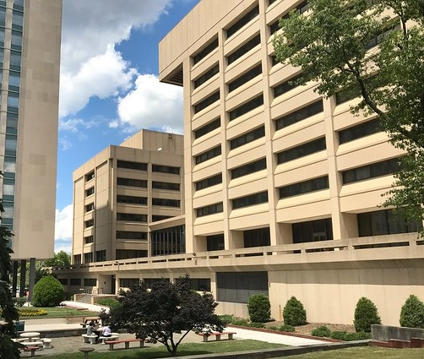

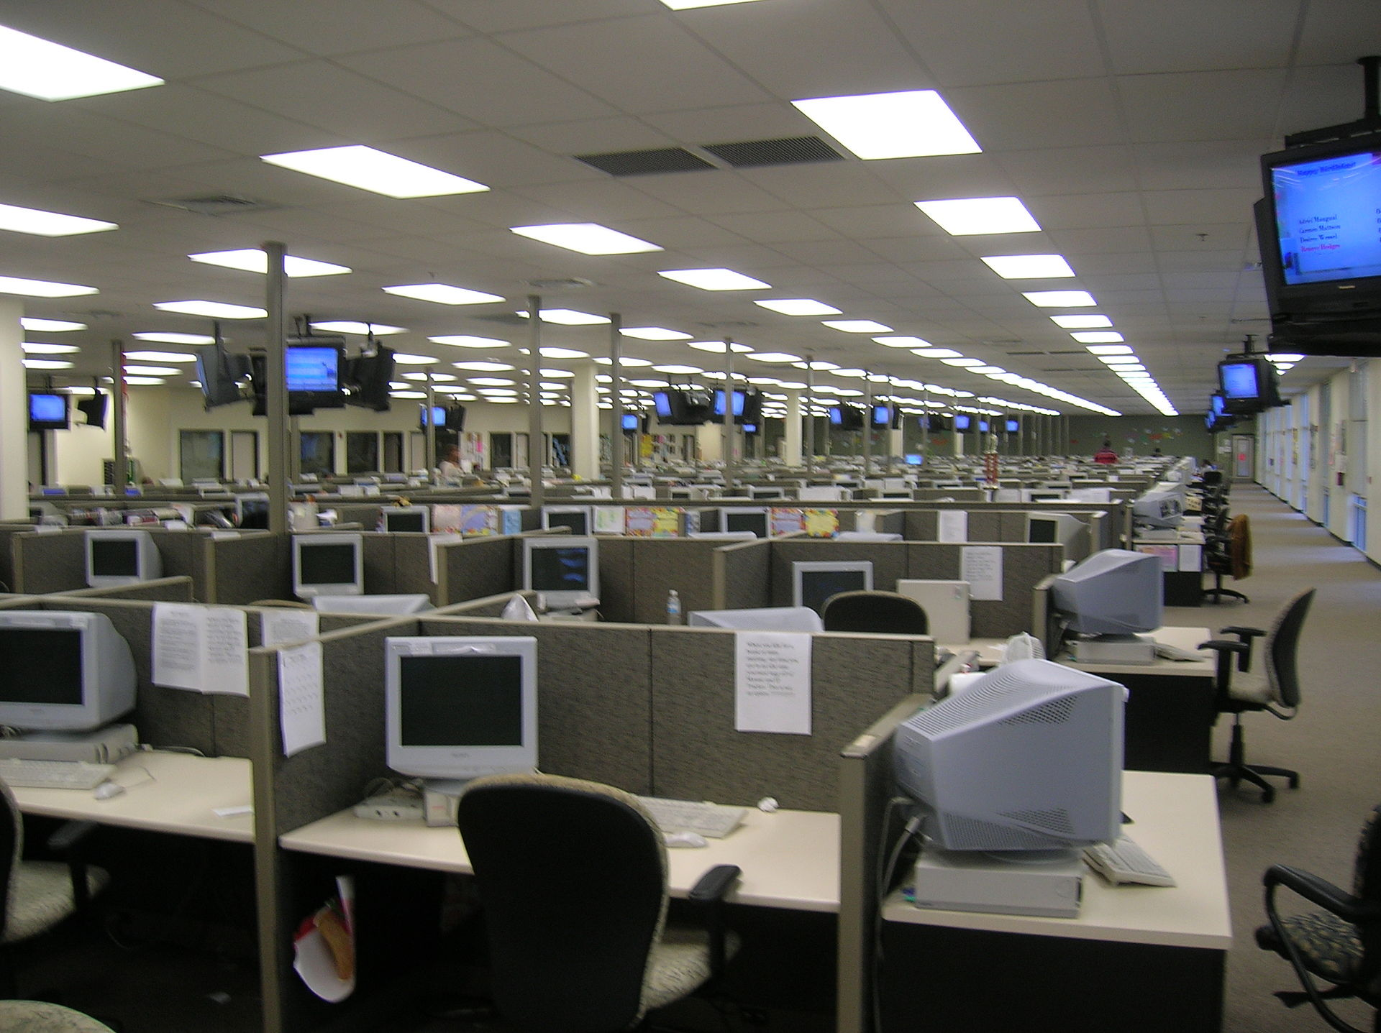
As Designed Assessment
Want to buy building?
Want assessment first
Get energy bills
Do a walk through
Enter data into Portal
Score shows high energy usage
Currently 24/7 call center
Re-rate with As Designed
Neutralized operating conditions = Better rating
Notes:
The As Designed process involves an on‐site visit by a Building Energy Modeling Professional (BEMP) to confirm that the modeling inputs are consistent with the building as constructed. The process:
Models the building using standardized operating assumptions and modeling inputs (from COMNET).
Calculates the rating using data generated from the model
Allows for comparison of buildings with very different operating parameters
Allows for comparison of a building’s current energy efficiency (In Operation) to the building’s potential energy efficiency
The owner is able to compare different buildings without including effects of the current occupants.
The Operator is able to determine whether they are achieving the full designed potential for a particular building.
The As Designed rating may be a useful tool for real estate transactions.
The estimated time to input the required data into the Portal is approximately 30-60 minutes depending on the size of the building and how much data is being input. This assumes that all the data is readily in hand at the time of input.

Slide 15
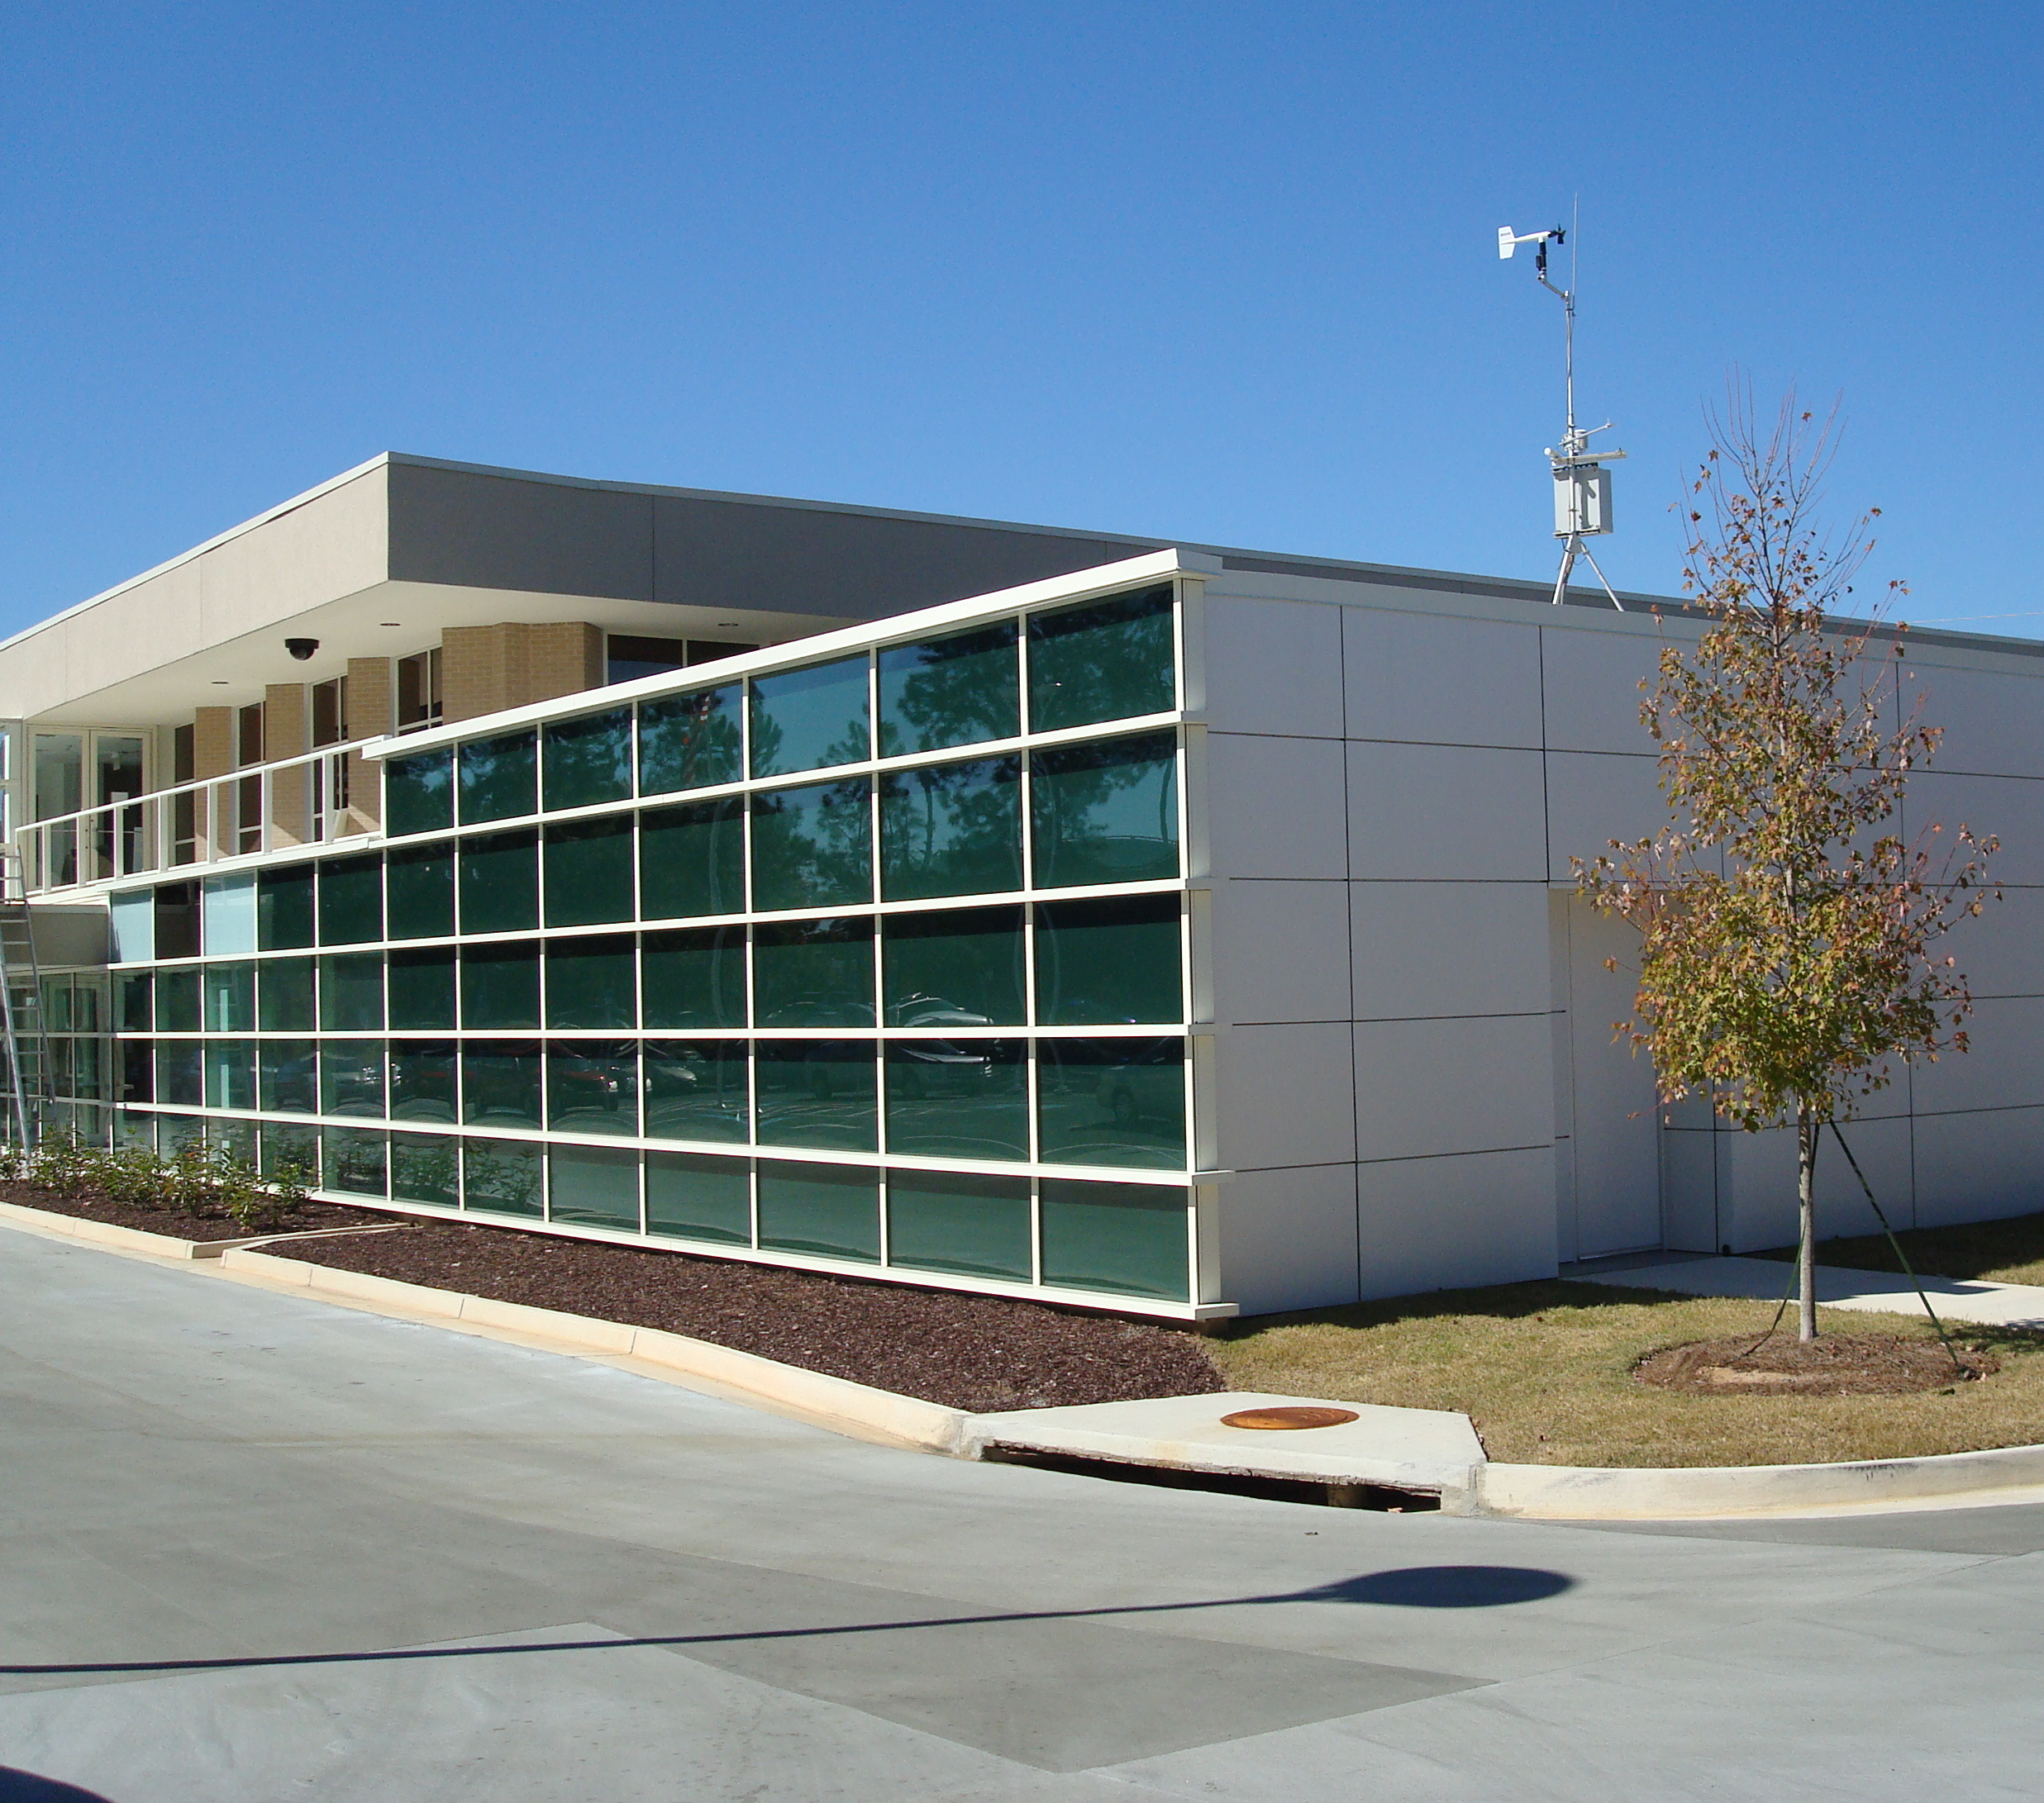


As Designed Rating
New building operating less than 12 months.
Evaluate design options
Develop final model using as-built conditions
Get As Designed rating
Determine if building has energy efficient design based on assets
Notes:
Because metered data is not required, the As Designed rating can be used on new buildings that have not yet been operational for a full 12 months as well as on existing buildings that have been operating for a long time.
The As Designed process can also be applied doing the design phase or construction phase to evaluate different design options. Because the As Designed rating is neutralized for occupancy and operation conditions, the design options can be compared solely based on how the building assets (bricks and mortar) and systems are expected to perform.
Note that the rating/score cannot be finalized/awarded until the building is fully constructed and the as‐built conditions are finalized.

Slide 16
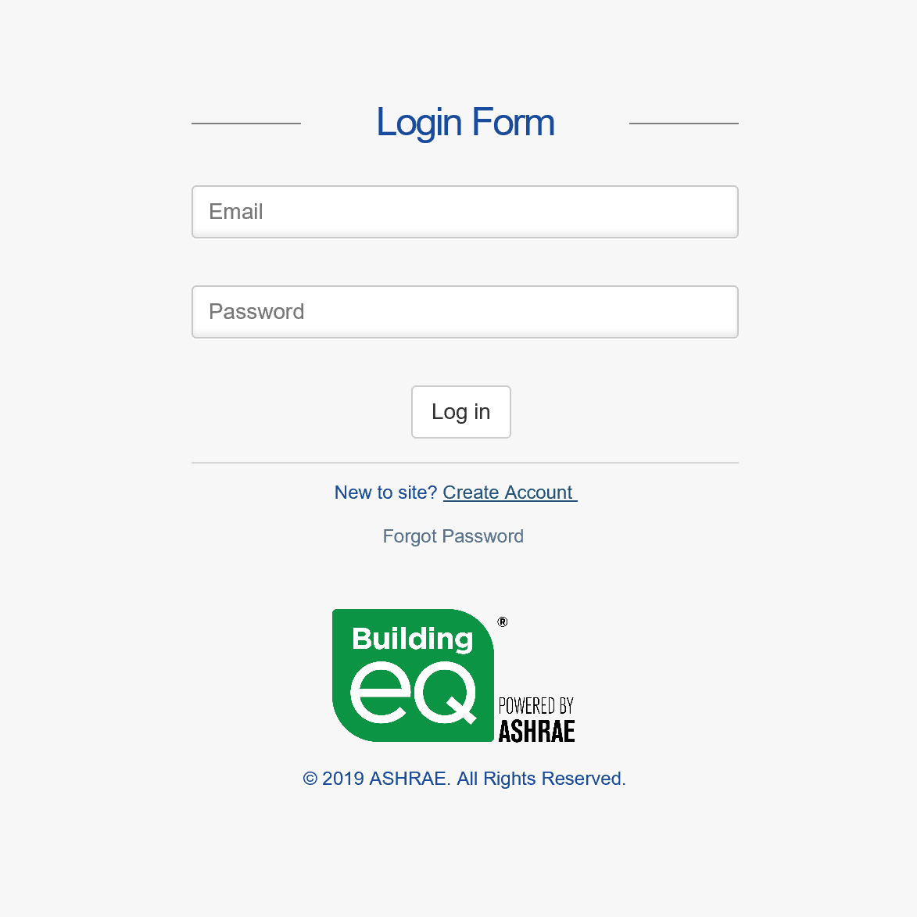
Building EQ Tour - Overview
Building EQ Portal is an online tool
Anyone can use it and get a Building Performance Score
Only credentialed users can submit a project for ASHRAE approval
Reports available for approved projects
Notes:
The Building EQ Portal is an online tool that includes:
Online data entry and submission process
Download of metered energy data from ENERGY STAR™ Portfolio Manager
The Building EQ Performance Score rates the building’s performance and is free to all users.
Anyone can use the Portal to get the Building EQ Performance Score (i.e., the rating) which shows on the screen once the required data is entered.
Projects must be submitted by a credentialed practitioners for an official Building EQ rating. A credentialed practitioner signs off on the project by agreeing to the Terms and Conditions (TOC) and providing their signature on the Project detail screen for that project. Credential users include ASHRAE BEAP, ASHRAE BEMP, and Professional Engineer).
There is a one‐time set up fee of $25 for non‐members and $15 for ASHRAE members to verify the credentials of Professional /Chartered Engineers.
The fee is waived for BEAPs and BEMPs as the credentials for these Certified Providers can be automatically verified within ASHRAE’s systems.

Slide 17
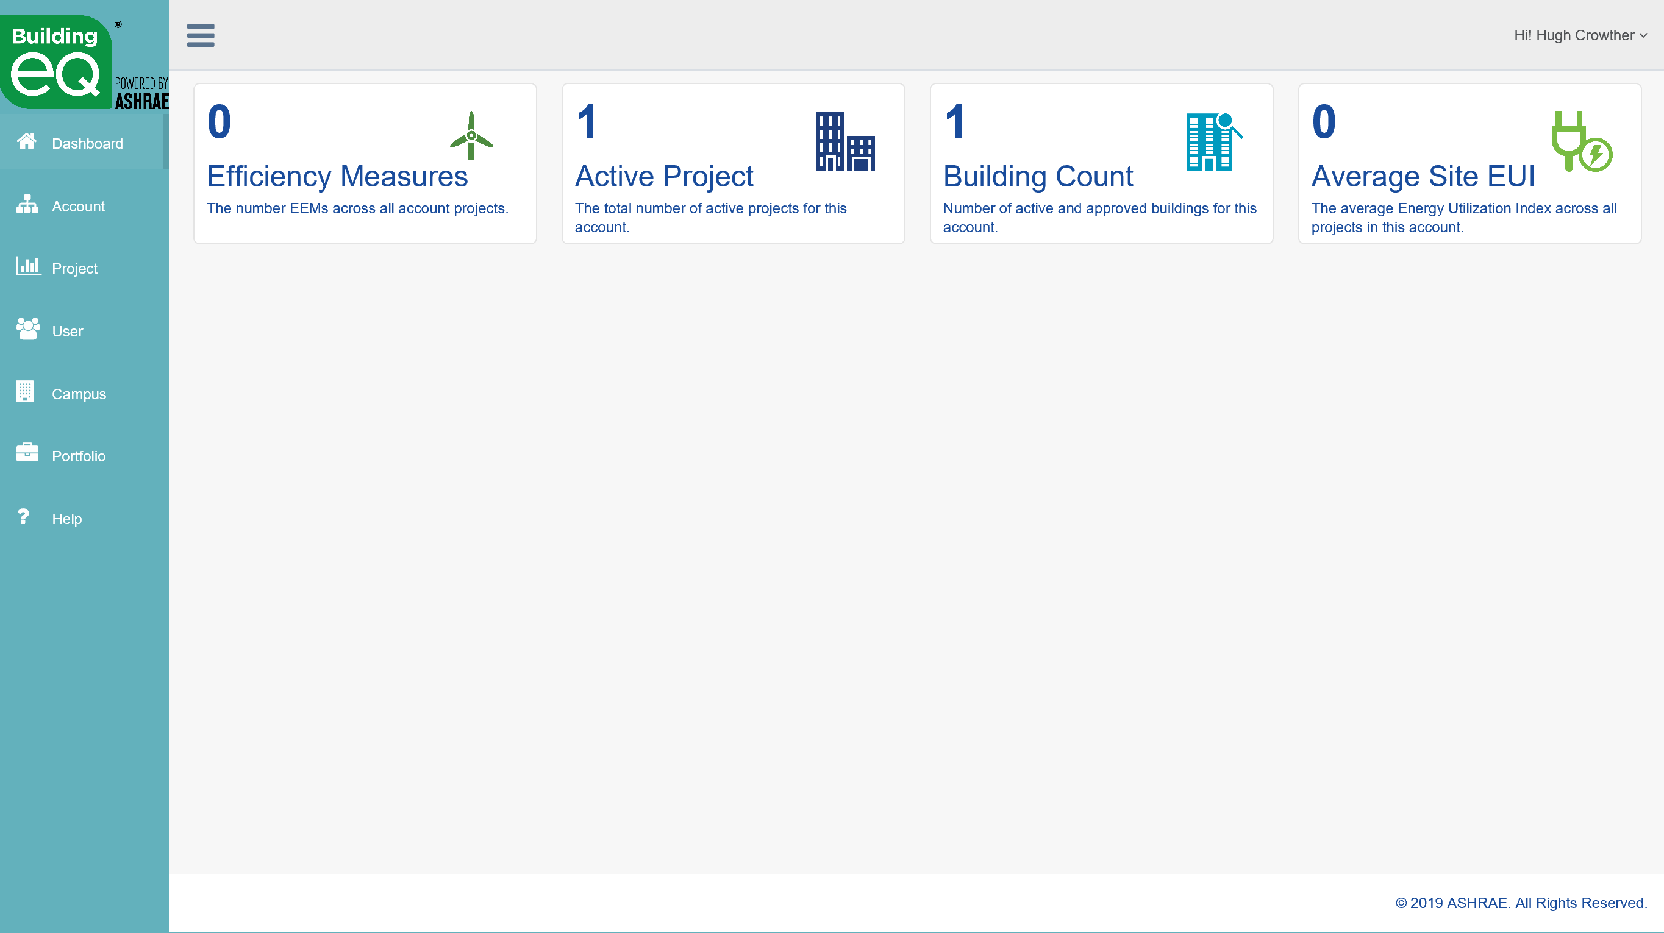
Building EQ Tour - Overview
Baseline calculations align with 2003 ENERGY STAR Portfolio Manager when the building type allows.
All other baselines align with Standard 211 methodology
Baselines adjusted by Climate Zone & applicable internationally
Communicates with BuildingSync to allow data transfer between applications
Notes:
BuildingSync is BEDES-compliant XML schema for data transfer that allows for the output or input of data files form one application to another. For Building EQ, it will initially be inputting data from another source into the Portal.
The calculation of the median EUI has been aligned with ENERGY STAR using Architecture 2030’s Zero Tool which will bring Building EQ Performance Scores more in line with ENERGY STAR Portfolio Manager scores. This calculation methodology is available for all ENERGY STAR building types in the US and Canada.
The Building EQ Portal uses methodology aligned with ASHRAE Standard 100 for all other building types in the US and Canada and for all building types in the rest of the world.

Slide 18
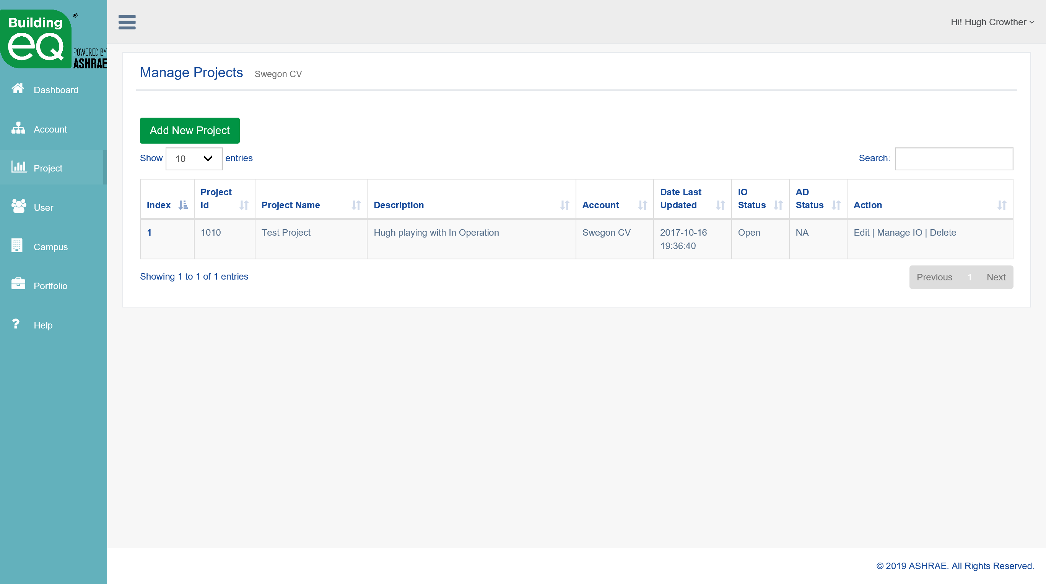
Building EQ Tour – Project Options
Manage projects by account, portfolio, and campus
Maintain project data in one location
Return to unfinished projects at a later time
Create default building and copy to new project
Notes:
The Building EQ Portal allows you to group the projects in your account into campuses and portfolios. You can use these two designations to organize and group your projects.
The Copy Project feature creates a new project with the exact information as the original file. The new file is automatically created with “Copy 1” added to the end of the original file name. The new project can be renamed and edited as needed. This feature can be used to copy any project at any time during the data entry process or after the project has been submitted. You could use this feature to:
Update a previously submitted project with new Utility, EEM, and/or IEQ information.
Create an As Designed (AD) project for a building that has previously been submitted as an In Operation (IO) project, but needs to have some information that is different
Enter historical data on a building without having to update the static building information with each new project.
Start a new project with similar information to reduce required data entry.

Slide 19
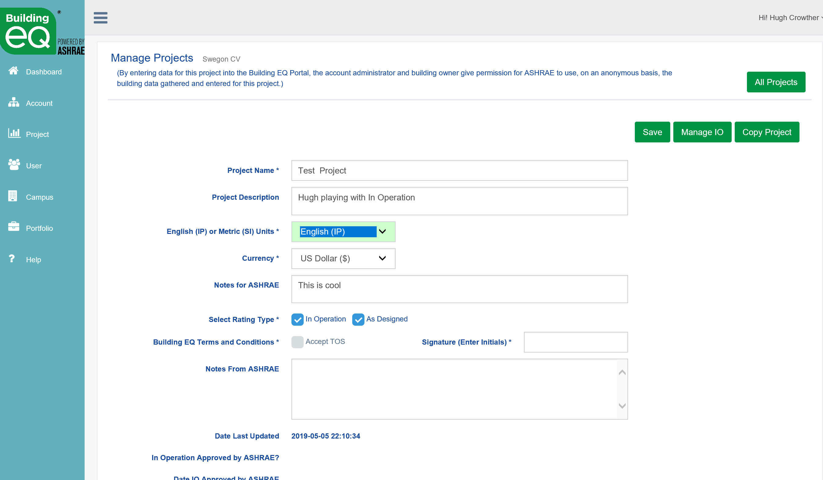
Building EQ Tour – Project Options
  As Designed, In Operation, or both
  English, French, & Spanish languages
  SI (Std International) or IP (Inch-Pound)
  All Countries, All Climate Zones
  Country specific currency
Countries and currencies added to pull-down menus as needed
Notes:
The metrics (SI or IP), currency type (by country), and rating type (In Operation or As Designed or both) are selected from the Manage Project page.
The climate zone is selected on the data input screens.
The language (English or French) is selected for the user on their user set up page.
Currency is only used in the energy cost calculation on the energy tab and is done in the currency selected for the project. No additional currency exchange calculation is required.

Slide 20
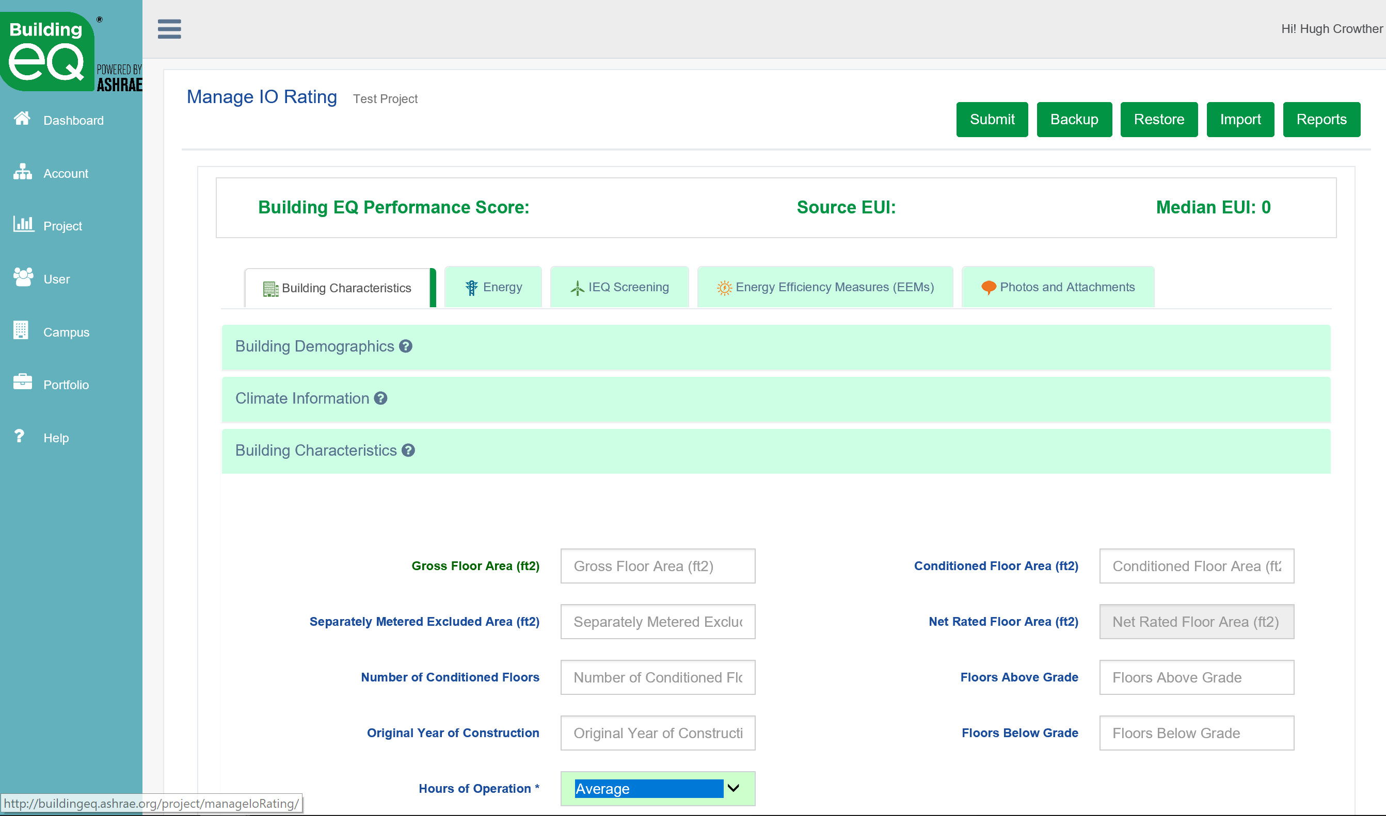
Building EQ Tour – Portal Screens
  Main Tabs Include:
  Building Characteristics
  Energy
  IEQ Screening
  Energy Efficiency Measures
  Photos and Attachments
Notes:
The Data input screens are arranged by Tabs and Accordions.
The Tabs (Building Characteristics, Energy, IEQ Screening, Energy Efficiency Measures, and Photos/Attachments) are organized horizontally across the screen.
Each tab has multiple accordions below it vertically that open and close as needed to enter data.
Once data entry begins a green check mark on the accordion indicates that all the required data for that accordion has been successfully entered and saved. A red “X” on either the accordion or tab indicates that some data is missing or does not fit into the required parameters.

Slide 21
Building EQ Tour – Data Input
Data Input:
  Accordion menus under each Tab
  Inputs adjust based on your building type
  Answer questions related to just your building type
Notes:
The Data input screens are arranged by Tabs and Accordions.
The Tabs (Building Characteristics, Energy, IEQ Screening, Energy Efficiency Measures, and Photos/Attachments) are organized horizontally across the screen.
Each tab has multiple accordions below it vertically that open and close as needed to enter data.
Some fields require additional accordions that are only visible if that field is used.
Once data entry begins a green check mark on the accordion indicates that all the required data for that accordion has been successfully entered and saved. A red “X” on either the accordion or tab indicates that some data is missing or does not fit into the required parameters.

Slide 22
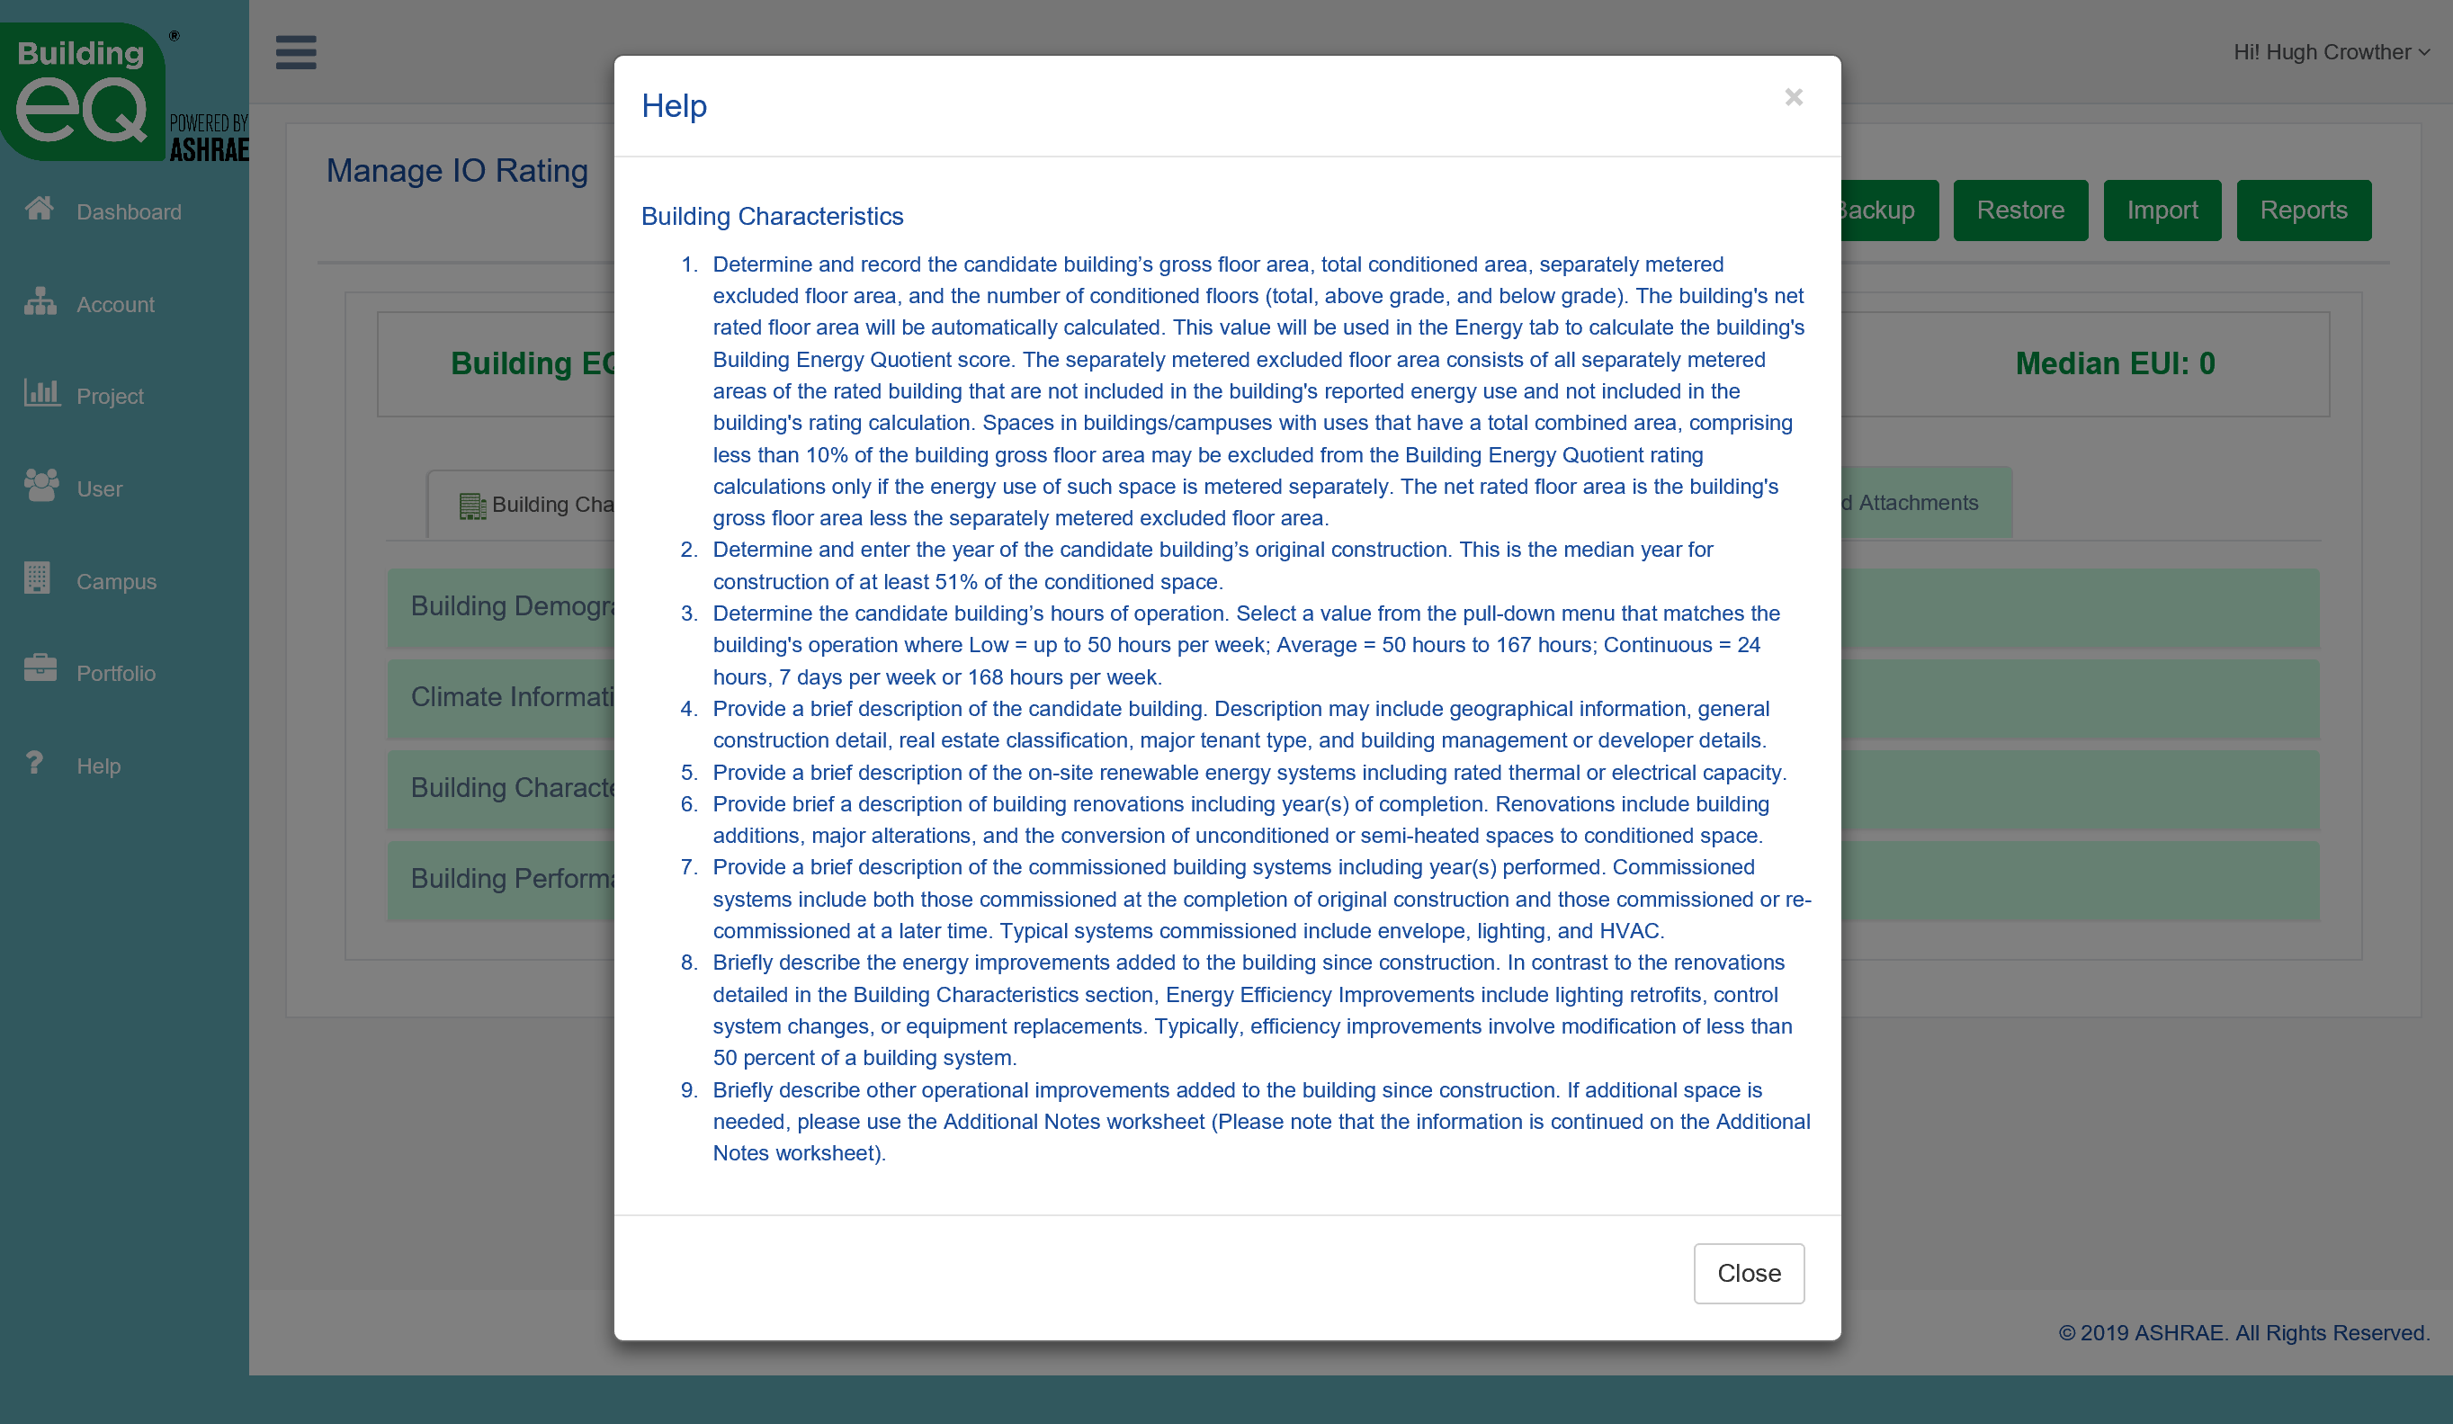
Building EQ Tour - Help
Help screens provide explanation, suggestions
Immediate notifications
Errors (must be fixed)
Warnings (data seems unusual)
Allows for immediate corrections
Notes:
The Building EQ Portal uses several different symbols to communicate the validation status of your project.
The question mark indicates that there is a help screen associated with the field or tab that will provide specific guidance relative to that field or tab.
The yellow triangle is a validation warning that signals that an entered value is outside the normally expected parameters for that field. A warning message will appear in yellow text at the top of the accordion to let you know what specific field is triggering the warning. The warning allows you to verify that you have entered the information correctly. Validation warnings will not prevent you from submitting your project for approval.
The red X mark signifies a validation error indicating that either required information is missing or that an entered value is invalid. An error message will appear in red text at the top of the accordion to let you know what specific field is triggering the error and what action is needed to correct it. A project cannot be submitted for approval until all validation errors have been addressed.
The green check mark indicates that all required data has been entered into that accordion and that all validation tests have been met.

Slide 23
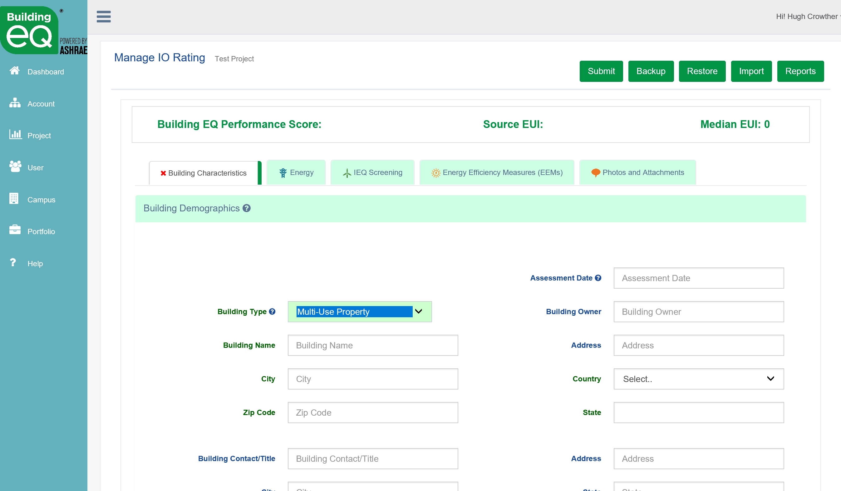

Building EQ Tour – Building Types
Extensive building types
Multiple use properties
Lab Buildings
  Most detailed lab benchmarking available
  Accounts for multiple lab types, hours of operation, and lab area ratio
Notes:
Available building types are noted in the pull down menu for Building Type in the Building Demographics accordion (Building Characteristics tab).
Buildings are listed by broad building activities that are broken down into more specific building types.
Match your building’s main use activities with the broader categories and then more specifically within the sub-categories underneath
A multiple use building contains multiple principal building activities in a single building and a property contains multiple buildings. A candidate building may be rated as a multiple use building/property using the rules detailed in the definitions including on the main Help screen in the Portal.
Lab Buildings: in order to produce a more accurate baseline median EUI for Lab buildings, the Building EQ Portal uses a calculation methodology that accounts for multiple lab types, hours of operation, and the lab area ratio.
Existing methodologies in other programs do not distinguish between different lab types or the percentage of lab area in a lab building (lab area ratio) making it difficult to get a fair comparison of performance.

Slide 24
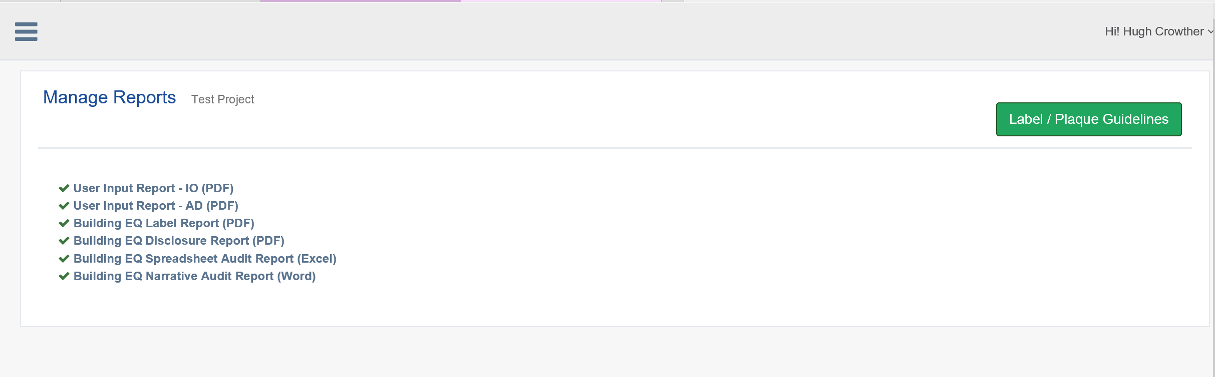
Building EQ Tour - Reports
  FREE
  FREE
  $50
  $50
  $200
  User Input Report – PDF of Portal inputs
  Building EQ Label Report – graphically shows your score
  Disclosure Report – PDF of key energy performance data
  Spreadsheet Audit Report (Excel) – Level 1 Energy Audit
  Narrative Audit Report (Word) – Level 1 Energy Audit
Notes:
The following items are delivered by the Portal:
Building EQ Label Report - Free to credentialed users for approved submissions
Building EQ Disclosure Report - Available for a $50 fee to credentialed users for approved submissions
Building EQ Spreadsheet Audit Report - Available for a $50 fee to credentialed users for approved submissions
Building EQ Narrative Audit Report - Available for a $200 fee to credentialed users for approved submissions
Also available but not listed on slide:
Calculated Building EQ Performance Score - Visible at top of Portal page after inputting minimum required data, Free to all users
User Input Report - Recaps all data entered into the Portal, Free to all users
Blank report can be printed for use of data collection offline

Slide 25

Building EQ Label Report
Visual indicator of Building EQ Performance Score on a barometer/scale
Free to credentialed user for approved submissions
Buildings that like their score can get a plaque for display
Notes:
Building EQ Label Report
Graphic representation of Building EQ Performance Score score
Free to credentialed users for approved submissions
Can be used to create a building plaque (see Plaque Guidelines on Portal)
Note: The buiding’s calculated Building EQ Performance Score is visible at top of Portal page after inputting minimum required data and is available and free to all users

Slide 26
Building EQ Performance Score
Building Performance Score opens dialog on improving the building
In Operation based on actual energy costs – Resonates with decision makers
As Designed based on standardized model – Provides additional information
Measured on a fixed scale showing movement towards Zero Net Energy
Notes:
Benefits of the Building EQ Performance Score:
The score provides an indicator of how the building is performing and along with additional information produced during the assessment process allows for a conversation with the building owner on how to improve the building’s energy performance.
The In Operation assessment:
Based on actual energy costs
Resonates with decisions makers
Provides actional recommendations for improvement
The As Designed evaluation:
Based on standardized model of the building
Provides additional information for decision makers
Indicates the building’s potential energy performance

Slide 27
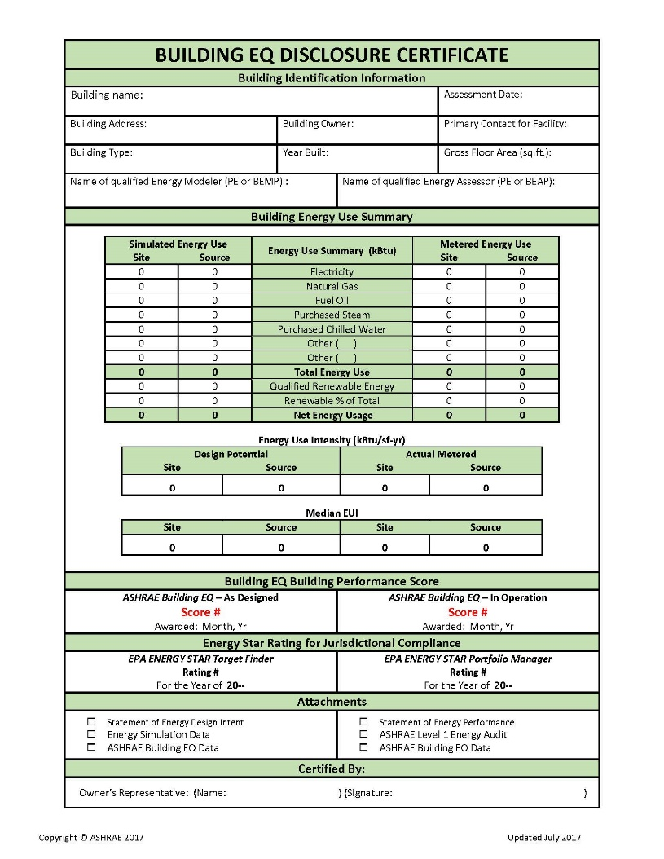
Building EQ Disclosure Report
Presents key energy information
Documents compliance with disclosure ordinances
Provides data for Real Estate transactions
$50 to credentialed practitioners for approved submissions
Notes:
Building EQ Disclosure Report
Presents summary of building's energy use and Building EQ Performance Score
Provides key energy use information for compliance with disclosure ordinances
Suitable for real estate transaction energy disclosure
Available for a $50 fee to credentialed users for approved submissions

Slide 28


Building EQ & Level 1 Energy Audits
Efforts are very close
Field data is almost the same
Site visit required for both
Building EQ delivers a Level 1 Energy Audit Report aligned with ASHRAE Standard 211
Customer gets understanding of how building ranks against similar buildings AND the initial evaluation on how to improve the building
Notes:
ANSI/ASHRAE/ACCA Standard 211-2018 Standard for Commercial Building Energy Audits
Information on a building energy’s use is the critical first step in making the necessary changes and choices to reduce energy use and costs.
The Building EQ In Operation assessment process:
focuses on the building’s metered energy use for the preceding 12 to 18 months.
includes the collection of information that aligns with an ASHRAE Level 1 Energy Audit
helps in the preparation of an ASHRAE Level 1 Energy Audit report
provides building owners with building‐specific energy savings measures with estimated costs and payback information that can be used to improve building energy performance
.

Slide 29

ASHRAE Standard 211
Normative language standard for energy audits
Consistent approach to energy audits
Raises and maintains the bar
Level 1 Energy Audit is initial review that identifies possible areas for improvement (EEMs)
Starts conversation with building owner for further investigation, action, and improvement
Notes:
ANSI/ASHRAE/ACCA Standard 211-2018 – Standard for Commercial Building Energy Audits
EEM = Energy Efficiency Measures
The basic parts of a Level 1 energy audit are:
Energy‐use Analysis – review of monthly energy bills and utility information
Walk‐thru Survey
Identification of low‐cost/no‐cost energy improvement measures
Estimated Costs and Savings
Summary of Special Problems/Needs
The Building EQ In Operation assessment process:
provides a consistent process for evaluating a building’s energy use
identifies actional recommendations of EEMs that can be used to improve building energy performance
allows a building to benchmark their building now and then re‐assess after improvements have been made to verify the energy savings.

Slide 30
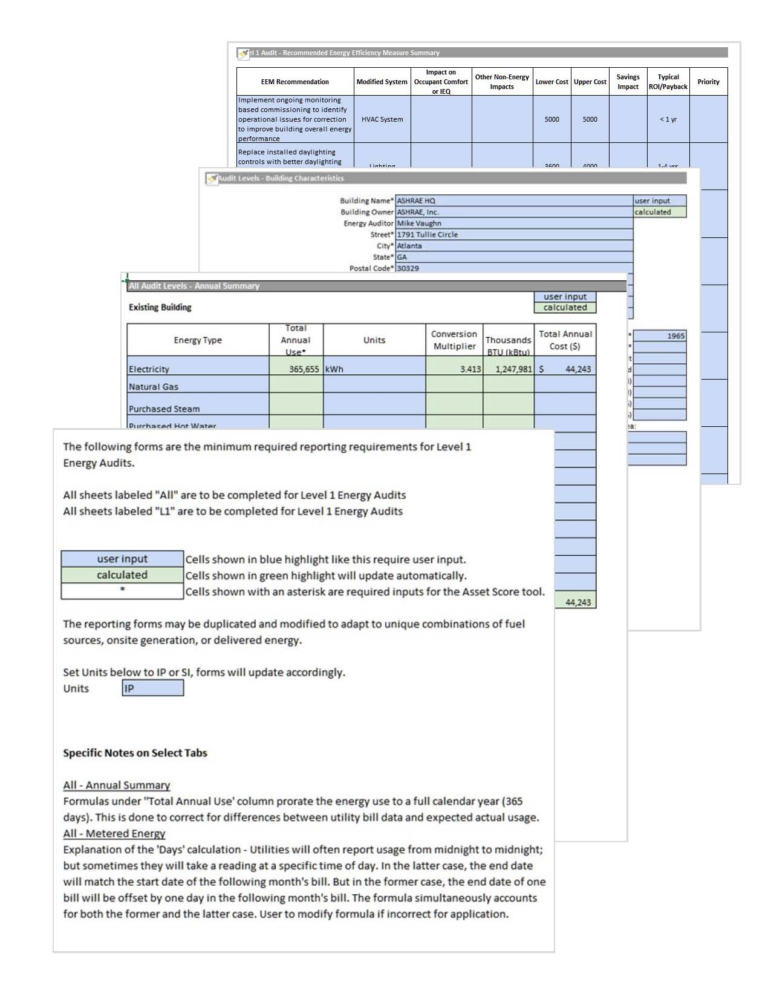
Building EQ & Level 1 Energy Audits
In Operation aligned with Standard 211 Level 1 reporting requirements
Blank forms and device responsive screens to collect data while on site
Extensive library of EEMs from pull-down menus in Portal
Building EQ Spreadsheet Audit Report auto populates Std 211 spreadsheets
Notes:
ANSI/ASHRAE/ACCA Standard 211-2018 Standard for Commercial Building Energy Audits
EEM=Energy Efficiency Measures
The Building EQ In Operation assessment process is aligned with and helps with the preparation of an ASHRAE Level 1 Energy Audit.
Energy Efficiency opportunities are selected from pull‐down menus of standardized options. Free form fields are also available.
User Input Report
A blank version can be printed before a project is started and used to collect data offline – NOTE: the blank version is available from the main help screen
Final report documents the data entered into the Building EQ Portal for a specific project
A final version can be printed for a project to document the data entered.
The report is free to all users for all submissions
Building EQ Spreadsheet Audit Report
ASHRAE Level 1 Energy Audit spreadsheets in MS Excel format as required by Standard 211
Auto populated with all information collected during In Operation assessment
Additional information entered by user
Available for $50 to credentialed users for approved submissions
NOTE: not all required data is currently collected during the Building EQ process – but ASHRAE is working to add more fields to increase the data consistency

Slide 31
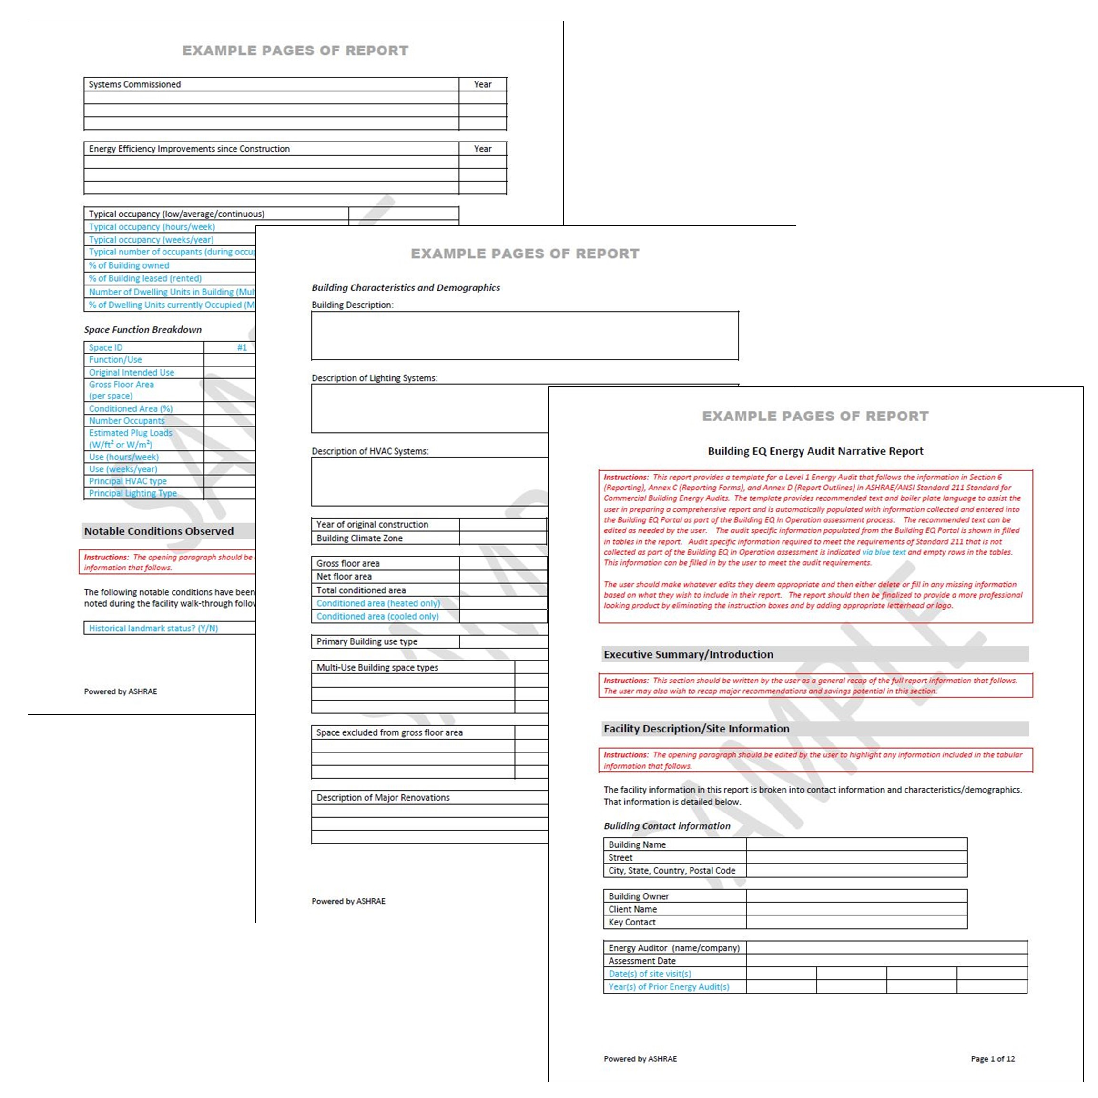
Building EQ Narrative Audit Report
  Customizable MS Word report template
  Meets Std 211 Level 1 report requirements
  Auto-populates data from Portal into report
  Saves report preparation time for Assessor
  Can be edited and tailored to include additional, specific jurisdictional requirements
  Allows for consistent reporting format regardless of who produces report
  $200 to credentialed practitioners for approved submissions
Notes:
Building EQ Narrative Audit Report
Template for a full narrative ASHRAE Level 1 Energy Audit report in MS Word format
Follows ASHRAE Standard 211 reporting requirements
Auto populated with all information collected during In Operation assessment
Additional information entered by user
Available for $200 to credentialed users for approved submissions
Specific ways this report is useful:
Provides recommended text and boiler plate language to assist the user in preparing a comprehensive Level 1 Energy Audit report.
Audit specific information populated from the Building EQ Portal fills in tables in the report
Auto population saves data entry and report preparation time
Provided in MS Word format so that all text can be edited as needed by the user.
User can add or delete information based on what they wish to include in their report
Can be customized to provide a more professional looking product by adding appropriate letterhead or logo.

Slide 32
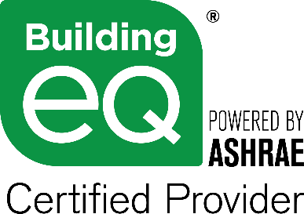
Building EQ Credentialed Users
Official submissions require:
PE licensed in the jurisdiction where project located
(Includes Chartered Engineer & International Professional Engineer)
or
ASHRAE Certified Provider
  Building Energy Assessment Professional (BEAP) for In Operation rating. www.ashrae.org/BEAP
  Building Energy Modeling Professional (BEMP) for As Designed Rating www.ashrae.org/BEMP
New credential options being added:
AEE Certified Energy Auditor, Certified Energy Manager, and EMA Energy Management Professional
Notes:
Unlike many other programs (i.e., DOE Asset Score), Building EQ requires a credential user to submit a project for approval to get an official Building Performance Score and to access the reports. A credentialed user is eitehr a BEAP, BEMP or a licensed Professional/Chartered Engineer (US, UK, Canada, International).
There is a one-time set up fee of $25 for non-members and $15 for ASHRAE members to verify the credentials of Professional /Chartered Engineers.
The fee is waived for BEAPs and BEMPs as the credentials for these Certified Providers can be automatically verified within ASHRAE’s systems.
The bEQ Certified Provider logo can only be used by individuals certified by ASHRAE as Building Energy Modeling Professionals or Building Energy Assessment Professionals. Full guidelines for the use of the logo are available from ASHRAE.
To learn more about becoming ASHRAE certified, visit www.ashrae.org/bemp or www.ashrae.org/beap.

Slide 33
Building EQ Energy Genius Award
Recognizes excellence in the assessment of building energy performance
Requires submission of a Building EQ project
  In Operation project to complete a Standard 211 Level 1 Energy Audit of building
  As Designed project to complete an asset rating of building
Judging based on Building EQ project information, building performance/design improvement, complexity of building, involvement of students, use of ASHRAE resources
More Details Coming Soon
Notes:
The Energy Genius Award recognizes excellence in the assessment of building energy performance. This differs from the ASHRAE technology awards which recognize excellence in the successful application of design innovation incorporating ASHRAE standards and good mechanical design.
The vehicle for the Energy Genius Award to assess building energy performance is through the use of the ASHRAE Building EQ Portal program and Building EQ assessment process through one of the following ways:
Completion of an ASHRAE Standard 211-compliant Level 1 Energy Audit with the assistance of ASHRAE Building EQ and a submission of an ASHRAE Building EQ In Operation project for an operational rating;
Completion and submission of an ASHRAE Building EQ As Designed project for an asset rating.
Portal submissions shall be evaluated, at a minimum, according to the following criteria in both categories, unless otherwise noted.
The completion of all fields for the project submission, including optional fields
For In Operation submissions: Improvement of building performance as a result of a Building EQ Assessment.
For As Designed submissions: Most improved building design as a result of conducting As Designed assessments during design and then upon building completion/occupation.
Most innovative way to include students in the Building EQ submission process.
The complexity of the building and systems that were audited;
References to ASHRAE Standards, Guidelines, and publications, as appropriate in method and analysis descriptions.
Recognition will be given at a Spring ASHRAE Building EQ Committee Virtual Meeting to the winning submissions. Each winning submission receives the following:
A technical feature in an issue of the ASHRAE Journal of the submitted project;
A case study produced by the Building EQ Committee to be featured on the ASHRAE Building EQ website at www.ashrae.org/buildingeq; and
Digital Energy Genius award certificates to each user associated with the project submission.
Plaque and recognition at the ASHRAE Annual Meeting plenary session.

Slide 34

Summary: Building EQ
Benchmarking, assessment, and auditing tool
Performs both In Operation and As Designed ratings
Aligns with ASHRAE Standard 211 Level 1 Energy Audits
Helps make bad buildings good and good buildings great
Consistent benchmarking & audit formats from a group of contractors
Flexible for managing large portfolios of buildings and users
Compares buildings via CZ rather than national boundaries

Slide 35

Check it out!
www.ashrae.org/BuildingEQ
www.youtube.com/watch?v=8UprJpl5cMs&t=3s
www.youtube.com/watch?v=K45K0YfOjpU&t=45s
Notes:
Access the Building EQ Portal at www.ashrae.org/buildingEQ
Questions can also be sent to buildingEQ@ashrae.org
Building EQ webpage: www.ashrae.org/buildingEQ
Building EQ Video: https://www.youtube.com/watch?v=8UprJpl5cMs&t=3s
Building EQ Training: https://www.youtube.com/watch?v=K45K0YfOjpU&t=45s

Slide 36
References
BuildingRating Maps: https://www.buildingrating.org/jurisdictions
EPA ENERGY STAR: www.energystar.gov
DOE Asset Score: https://buildingenergyscore.energy.gov/
USGBC LEED: www.usgbc.org/leed
Green Globes: www.greenglobes.com/
BOMA 360: www.boma.org/360

